Slide 1
2025 Benefits Open Enrollment Meeting
October 20th – November 2nd
Notes:
Welcome to Grande’s 2025 Open Enrollment Presentation! Let's get started to review our benefit offerings for 2025.

Slide 2
Agenda
Review summary of 2025 benefit updates
Provide overview of benefit plans
Review how to enroll in UKG
Understand available resources and next steps
Notes:
Grande is committed to offering Associates competitive benefit offerings that support you and your family with their well-being.
In today's session, we will go over:
2025 benefit changes
Provide an overview of benefit plans
Review how to enroll in UKG
Discuss resources and next steps

Slide 3
What's Changing?
We received feedback that Associates and families would like more choices as it relates to benefits. Based on feedback, the following changes will be made for 2025:
Addition of a High Deductible Health Plan (HDHP) with a Health Savings Account (HSA)
Consolidation of medical networks
Addition of a Limited Purpose Flexible Spending Account
UMR Plan Advisor to assist with personalized care
Notes:
To get started, let's review what are the big changes for 2025. Earlier this year, we conducted a benefits survey and received valuable feedback. Based on the feedback, it helped the Benefits Team determine what Associates and their families are asking for, as a result, we will be making the following changes:
Adding an additional medical plan option which is a High Deductible Health Plan (HDHP) which also incorporates the introduction of a Health Savings Account (HSA)
There is a consolidation of medical networks
In addition to adding a HDHP, we will be adding a Limited Purpose Flexible Spending Account
Lastly, we will introduce UMR Plan Advisor to assist with personalized care when you contact UMR

Slide 4
Medical/Prescription
Notes:
First, let's talk about our medical and pharmacy plans. Grande partners with UMR as our medical plan administrator and CVS Caremark as our pharmacy benefits manager.

Slide 5
Medical
This year, we are excited to introduce two medical plan options: a Preferred Provider Organization (PPO) and a High Deductible Health Plan (HDHP)!
Plans are powered by UMR, which provide access to a wide network of healthcare providers
Preventative care is covered at 100%
Covered at 100%: annual wellness exams, immunizations, colonoscopy, mammogram, etc.
Prescription coverage is included in both plans
New medical ID cards will be mailed to your home in late December
Notes:
New this year, Grande is now offering the choice between two medical plans. Associates will be able to choose between a Preferred Provider Organization (PPO) plan, which is what we have always offered, or new this year, a High Deductible Health Plan (HDHP).
Both plans are powered by UMR
Preventative care is covered at 100%
Prescription coverage is included with both plans
New medical ID cards will be mailed to your home in late December, even if you remain on the same plan

Slide 6
PPO vs. HDHP
PPO
Lower deductibles
Lower out-of-pocket maximums
Higher monthly premiums
Copay applies for medical services and prescription costs
Grande contributes to Health Reimbursement Account (HRA)
HDHP
Higher deductibles
Higher out-of-pocket maximums
Lower monthly premiums
You pay entire cost of services, except for preventative care, until the deductible is met
Then you pay coinsurance to share the cost until you meet the out-of-pocket maximum
Grande contributes to Health Savings Account (HSA)
Notes:
This slide helps represent the main differences between the PPO plan and the new HDHP.
First, the PPO plan offers lower deductibles with lower out of pocket maximums but higher monthly premiums.
A copay applies to medical services and prescription costs.
Lastly, Grande will contribute to a HRA for those enrolled in the PPO.
Whereas, the HDHP has higher deductibles and higher out of pocket maximums but lower monthly premiums.
With a HDHP, you may pay for the entire cost of service, including prescription costs, until your deductible is met.
This excludes any preventative services. Once the deductible is met, you will pay coinsurance or the plan will share the cost with you until the out of pocket maximum is met.
Grande will contribute to a HSA but you also have the opportunity to save your own dollars with a HSA.

Slide 7
Plan 1: PPO with HRA
Plan 1, PPO: the same medical plan that is currently being offered in 2024
Opportunity to utilize a Health Reimbursement Account (HRA)
Intended to cover illness or injury
Office visits
Hospital expenses
Prescription costs
Preferred Provider Organization (PPO)
Health Reimbursement Arrangement (HRA)
Grande funded account to pay for medical, prescription, dental and vision expenses
*You must be enrolled in a PPO to receive funds in your HRA!
Notes:
Going into detail on the PPO plan with the Health Reimbursement Arrangement (HRA)
This is the same plan that Grande has offered in the past with no changes.
The plan covers office visits, any hospital expenses and prescription costs
With the PPO, Grande funds the Associate's HRA. The HRA can be used for medical, prescription, dental or vision expenses that you might have to pay up front.

Slide 8
Plan 2: HDHP with HSA
Plan 2, HDHP: new medical plan option for 2025
Opportunity to utilize a Health Savings Account (HSA)
High Deductible Health Plan (HDHP)
Intended to cover illness or injury
Office visits
Hospital expenses
Prescription costs
Health Savings Account
(HSA)
Grande and Associate funded account to pay for medical, prescription, dental and vision expenses
*You must be enrolled in a High Deductible Health Plan (HDHP) to contribute funds to a Health Savings Account (HSA)!
Notes:
Next, going into detail on the HDHP plan with the Health Saving Account (HSA)
This is a new plan option for 2025.
Similar to the PPO plan, the HDHP covers expenses related to office visits, hospital expenses and prescription costs.
Keep in mind that with a HDHP, you are responsible for the entire cost of care until you meet the deductible. Once you meet the deductible, the plan will share the cost with you until your out of pocket maximum is met.
The HSA is funded by Grande but you also have the option of contributing to the HSA with your own pre-tax dollars.
The HSA can be used for expenses related to medical, prescription, dental or vision and is intended for you to help pay for those expenses you are required to pay until the deductible is met.

Slide 9
Deductibles
Pg. 24-25
PPO
Each family member must meet their own deductible
HDHP
Combined family's combined healthcare costs to meet the deductible
$1,000/$3,500
$0
$2,000
$0
$0
$0
$2,500
$5,000
OR
$0
$500
$0
$0
$1,000/$3,500
Notes:
The deductibles work a little differently on each medical plan.
First, on the PPO plan: each family member must each meet their own deductible with their own claims
(Show graphic) as shown here. (The graphic on the left side of the screen, under PPO, is shown to help explain what that might look like).
Next, on the HDHP: the deductible is combined between family members and their claims.
One person could reach the entire deductible or it could be a combination of family members
(Show graphic) as shown here. (The graphic on the right side of the screen, under HDHP, is shown to help explain what that deductible might look like).

Slide 10
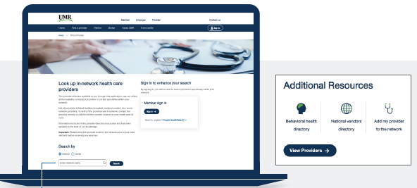
Medical Networks
New for 2025, Grande has consolidated medical networks under UMR
Eliminating the current Alliance network
UMR networks will support all Grande Associates with the Choice Plus network or Options network
Options Network will only be provided to Associates that reside in Columbia, Dane, Green, Rock, Sauk
Ensure your current provider is in network, utilizing the below steps
Go to www.umr.com and select Find a Provider
Search for United Health Care – Choice Plus or United Health Care - Options
For medical providers, choose View providers. For behavioral health providers (including counseling and substance abuse), select Behavioral health directory
Notes:
We completed a review to consolidate Grande's medical networks to create simplification and ease of use. With this change Grande is eliminating the Alliance network. Associates will now fall under the UnitedHealthcare Choice Plus network OR the UnitedHealthcare Options network.
The network you are in is based on where you live, so
Associates who reside in Columbia, Dane, Green, Rock, or Sauk counties will be placed in the Options network
Associates who reside in any other county will be placed in the Choice Plus network
You are automatically assigned a network based on your address – you do not need to select a network when enrolling in UKG.
To find an in network provider or to ensure your current provider is in network, visit umr.com, select "Find a provider," and enter your network name

Slide 11
Prescription Plan
The prescription plan is managed by CVS Caremark and coverage depends on the type of medication you have prescribed
PPO out-of-pocket maximums
Associate Only: $3,000
Associate + 1: $6,000
Family: $8,400
 | Plan 1: PPO | Plan 2: HDHP
 | In-Network
Generic | Deductible, 20% | Deductible, 20%
Brand | Deductible, 30% | Deductible, 20%
Non-Formulary | Deductible, 45% | Deductible, 20%
Specialty | Deductible, 20% | Deductible, 20%
Save money and time
with Mail Order!
Notes:
Now let's talk about our prescription plan.
Grande’s prescription plan is included with the medical plan – both the PPO and HDHP plans.
The prescription plan is managed by CVS Caremark, but you can utilize many different pharmacies such as:
CVS
Walgreens
Shopko
Costco
Sam’s Club
And more
Our prescription plan has four tiers of drugs with varying coverage levels and costs. The four tiers of drugs are broken down into:
Tier 1 Generic Drugs
Tier 2 Brand Drugs
Tier 3 Non-Formulary Drugs
Tier 4 Specialty Pharmacy Drugs
The full description of each drug category is listed in your Open Enrollment book.
If you enroll in the PPO plan, your prescription drug costs apply towards an out of pocket maximum as noted on this slide.
If you enroll in a HDHP, your prescription drug costs are integrated with medical expenses. This means any medical and prescription expenses apply towards your deductible and out of pocket maximum.
As a reminder, you can do a 30 or 90 day supply of retail prescriptions or for your convenience you can do a 90 days supply of mail order prescriptions sent right to your door!

Slide 12
2025 Medical Premiums
Associate
Associate +1
Family
Bi-Weekly Premiums – Plan 1: PPO
Associate – Normal Rates | Associate Only - Discount | Associate & Spouse – Discount
$93 | $58 | N/A
$227 | $192 | $172
$330 | $295 | $275
Bi-Weekly Premiums – Plan 2: HDHP
Associate – Normal Rates | Associate Only – Discount | Associate & Spouse - Discount
$56 | $21 | N/A
$142 | $107 | $87
$200 | $165 | $145
Wellness program remains the same for 2025
Associate discount $35 bi-weekly
Spouse discount $20 bi-weekly
Notes:
The PPO and HDHP biweekly premiums are listed here. You can see that the current PPO plan premiums are slightly increasing for 2025. In addition, you can see the new HDHP rates for 2025. All rates are listed here as biweekly.
As a reminder, Associates and their spouses/domestic partners are eligible for a wellness discount by completing wellness activities in Asset Health.
The wellness program discount will remain the same for 2025
The Associate discount will remain $35 per paycheck if you reach 500 points in Asset Health by December 1st
The spouse/domestic partner discount will also remain the same at an additional $20 per paycheck if your spouse/domestic partner also reaches 500 points in Asset Health by December 1st
When you are enrolling in UKG, you will only elect the coverage level you would like. After December 1st, the Benefits team will determine which Associates met eligibility for the wellness program discount. You will receive the discount based on your points completion.

Slide 13
PLANSelect
To assist you in deciding between the two medical plan offerings, we are offering you the opportunity to utilize a decision-making tool, PLANSelect.
Complete a short five-minute survey to estimate medical costs based on premiums and medical expenses based on your specific situation.
This helps you understand the difference between the PPO and HDHP plan.
To access the decision-making tool, visit https://flimpdecisions.net/welcome/66db63285c42d
Notes:
This year with offering two medical plans, Grande is partnering with PLANSelect, a decision making tool to help Associates decide between the plan offerings
Associates can complete a short survey to estimate medical costs factoring in premiums and medical expenses based on your specific situation
This will help Associates understand the difference between the PPO and HDHP plan
To access PLANSelect, please visit the URL listed here or scan the QR Code

Slide 14
Dental
Notes:
Next, let's talk about our Dental plans. Grande partners with Delta Dental and Care Plus Dental to offer two dental plan options for Associates to chose from.

Slide 15
Plan Details
Delta Dental
Deductible ($50 per individual or $150 per family)
Basic/Major Restorative Services are covered at a percentage
Care Plus
No deductible for all services
Basic/Major Restorative Services are covered at 100%
Dental providers are limited to Dental Associates and Midwest Dental locations​
Only Midwest Dental and Dental Associates locations in WI
Dental Plan Contributions
Bi-weekly Rates | Delta Dental | Care Plus
Associate | $4.38 | $4.20
Associate +1 | $6.98 | $6.96
Family | $12.78 | $13.01
Notes:
Grande provides you with two plan options for dental insurance through Delta Dental or Care Plus.
The main difference is that you can see any dental provider through Delta, but with Care Plus you are limited to Dental Associates and Midwest Dental locations.
There are also a few differences in the coverage:
First, the deductible for each plan is different. Delta Dental has a deductible but the Care Plus plan has no deductible for all services received.
Under Delta Dental, services are covered at a percentage whereas the Care Plus plan covers 100% for services.
Lastly, Delta Dental allows for 4 cleanings per year. The Care Plus plan allows for 2 cleanings per year unless deemed medically necessary, then 4 cleanings are covered.
The biweekly premiums are listed out for each plan to assist you in comparing each plan.
Keep in mind that the Care Plus plan can only be used at Midwest Dental and Dental Associates locations in WI.

Slide 16
Vision
Notes:
Now let's discuss our Vision plans. Grande partners with National Vision Administrators to offer two vision plans to Associates.

Slide 17
Plan Details
National Vision Administration
Coverage under this plan includes:
$125 frame allowance
100% coverage for standard lenses
$150 allowance for contacts
You can only utilize the benefit for glasses OR contacts
*An eye exam is covered under Grande’s medical insurance plan.
Vision Plan Contributions
Bi-weekly Rates | 24-Month Plan | 12-Month Plan
Associate | $1.27 | $2.90
Associate +1 | $2.55 | $5.81
Family | $3.41 | $7.71
Notes:
Grande provides you with two vision options: a 12 month plan and a 24 month plan, both powered by National Vision Administrators.
The 12 month plan can be enrolled in one year at a time and you can utilize the coverage each year.
The 24 month plan allows you to be enrolled in the plan for two years. In addition, you can only utilize the coverage once in that two year period.
Both plans allow you to use the benefit for glasses OR contacts.
Keep in mind that if you enroll in the medical plan, your eye exam is covered under the medical plan.

Slide 18
Health Reimbursement Account (HRA)
Notes:
Let's discuss the Health Reimbursement Account or HRA, powered by WEX Health.

Slide 19
Health Reimbursement Arrangement (HRA)
Grande funded account if you enroll in the PPO Medical Plan
Meant to help offset a portion of your out-of-pocket costs
Amount received is based on coverage level
If applicable, FSA funds are used first before HRA funds are utilized
At the end of the year, up to $5,000 will rollover into the following year
Associate | Associate +1 | Family
$240 | $480 | $720
Notes:
If you enroll in the PPO medical plan then you will automatically be enrolled into a Health Reimbursement Account (HRA)
This is an account that Grande puts money into for you that you can use for medical/dental/vision expenses or other expenses such as over the counter supplies, towards deductibles or coinsurance.
If you enroll in Associate only coverage Grande will put in $240 for you to use for the year, if you elect Associate +1 Grande will put in $480 for you and your dependent to use and if you elect Family coverage Grande will put in $720 for you and your family to use for the year.
If you do not use up the funds this year, they will roll over into next year and you will receive a new set of funds next year if you select the PPO plan again
If at any point you drop the PPO plan coverage, you will have 90 days to use up the funds in your account
With a HRA, you will receive a debit card but you can also submit a claim reimbursement to WEX.
For some expenses, you will be required to submit documentation to support your expense. This information will need to be submitted to WEX.

Slide 20
Health Savings Account (HSA)
Notes:
Now we will discuss the Health Savings Account or HSA, powered by Optum Bank.

Slide 21
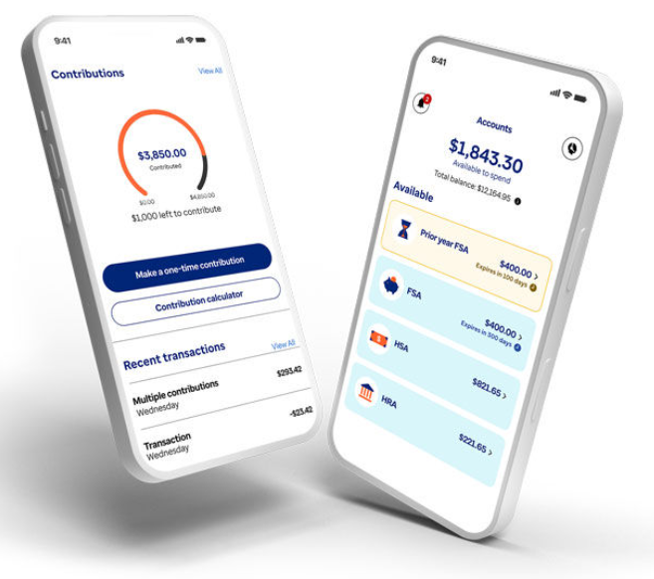
Health Savings Account (HSA)
HSA allows you to save pre-tax money for healthcare for now or in the future
Grande provides a contribution to an HSA based on your enrollment level, powered by Optum Bank
Funds will be deposited each pay period based on enrollment level
2025 IRS Annual Limits for HSA
 | Annual Grande Contribution | Bi-Weekly Grande Contribution | 2025 IRS Maximum*
Associate | $500 | $19.23 | $4,300
Associate +1 | $750 | $28.84 | $8,550
Family | $1,000 | $38.46 | $8,550
Catch-up (age 55 +) | -- | -- | $1,000
*Associate contributions are limited to the IRS maximum minus any Grande contribution
Notes:
If you enroll in the HDHP medical plan then you have the option to enroll in an HSA.
An HSA allows you to save pre-tax money for healthcare for now or in the future.
Funds must be in the HSA account before you can utilize them.
The HSA can be used on medical, prescription, dental, vision expenses. Any unqualified withdrawals are subject to taxes and penalty.
Grande will contribute funds to your HSA based on your enrollment level on a biweekly basis.
If you enroll in Associate only coverage Grande will contribute $500
If you enroll in Associate + 1 coverage Grande will contribute $750
If you enroll in the Family HDHP plan then Grande will contribute $1,000
The total contribution will be broken out into each pay period for the year
In addition to Grande's contribution, you can also contribute to your HSA, up to the IRS maximum. If you would like, you have the option to contribute money into a HSA when enrolling in UKG. If you would like to update your contribution amount throughout the year, you can update this at any time in UKG by submitting a Life Event.
Make sure you designate beneficiaries on Optum Bank's website.

Slide 22
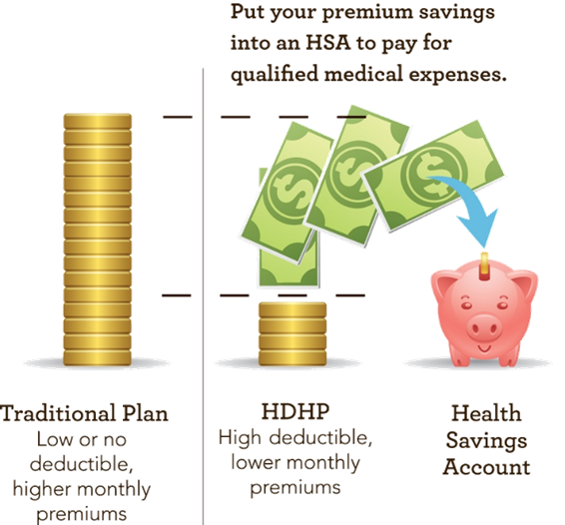
HSA Advantages
HSA dollars can be carried over from year to year
HSA accounts are portable, meaning the account goes with you
You can invest your balance which grows tax-free
Make tax-free withdrawals to pay for eligible healthcare expenses
Notes:
In addition to the HSA features we just discussed, there are also some additional advantages to an HSA:
HSA dollars can be carried over from year to year.
HSA accounts are portable, meaning the account goes with you if you were to leave Grande.
If at any point you drop the HDHP medical plan, you still have your HSA. This is an Associate owned account that stays with you.
You can invest your balance which grows tax-free. If you would like to explore investment options, you should work with Optum Bank to do so.
Lastly, you can make tax-free withdrawals to pay for eligible healthcare expenses.
Overall, the HSA is a triple-tax advantaged account that allows you to contribute tax-free, invest your balance and grow tax-free and make tax-free withdrawals for eligible expenses.

Slide 23
Flexible Spending Accounts (FSA)
Notes:
Next, let's discuss Flexible Spending Accounts or FSAs, powered by WEX. Grande offers you with 3 different types of FSAs.
A Health FSA
A Limited Purpose FSA
And a Dependent Care FSA
All 3 types allow you to save money from your paycheck, pre-tax, to be used for eligible expenses. We will break these down on the next few slides.

Slide 24
FSAs
Health FSA
Eligible expenses: medical, prescription, dental and vision
IRS limit: $3,200
Carryover: $640
Only available if you are not enrolled in an HDHP
Limited Purpose FSA
Eligible expenses: dental and vision
IRS Limit: $3,200
Carryover: $640
Only available if you enroll in the HDHP medical plan
Notes:
Starting with the Health FSA, this account can be used for eligible medical, prescription, dental, and vision expenses.
The most you can contribute to your Health FSA for the year is $3200, but this amount may increase for 2025 when the IRS releases the new limits
An FSA is a 'use it or lose it' account
You can carry over up to $640 of unused funds into the following year, but again, this amount is subject to change for 2025.
Any unused funds above $640 left in the account at the end of the year will be forfeited
You can only enroll in a Health FSA if you are NOT enrolled in a HDHP. This would be through Grande or another employer, such as coverage through a spouse or parent.
Next, let's discuss the Limited Purpose FSA. This account can be used for eligible dental and vision expenses only.
The IRS limit is the same as the Health FSA, or set at $3200, but is subject to change for 2025.
It is also a 'use it or lose it' so you can carry up to $640 over into the following year, subject to change for 2025.
Any unused funds above $640 at the end of the year will be forfeited
You can ONLY enroll in the Limited Purpose FSA if you are enrolled in an HDHP.

Slide 25
FSAs
Dependent Care FSA
Eligible expenses: childcare expenses, expenses incurred for the care of an incapacitated spouse/domestic partner or parent
IRS limit: $5,000
Use it or lose it – balance doesn't carry over into new year
Notes:
Lastly, Grande offers a Dependent Care FSA, which can be used for eligible childcare expenses or expenses incurred for the care of an incapacitated spouse/domestic partner or parent
The most you can contribute is $5,000 for the year
The Dependent Care FSA is also a 'use it or lose it' account.
Any unused funds at the end of the year will be forfeited. No balance carries over.

Slide 26
FSAs
No contribution changes can be made mid-year
Submit expenses with WEX by:
WEX mobile app
Website
WEX debit card (not Dependent Care FSA)
Save your receipts, supporting document is required
IRS requires you to provide documentation to confirm your expenses is an eligible expense
If you don't provide the necessary documentation, this amount could become taxable to you
Notes:
A few reminders to keep in mind about FSAs:
You cannot change your contributions throughout the year
To use your funds, you can pay out of pocket for your eligible expenses and submit a claim either online or through the mobile app OR you can use your WEX debit card that you'll receive in the mail. The debit card cannot be used for the Dependent Care FSA.
Next, make sure you save your receipts! Supporting documentation may be required. WEX will often come back and ask for documentation such as receipts or an Explanation of Benefits to ensure you are using the funds for eligible expenses.
If you are unable to provide the necessary documentation, your claims may be denied.

Slide 27
401(k)
Notes:
Now, let's discuss Grande's 401k plan, also referred to as Grande Associates Asset Accumulation Plan or GAAAP, which is powered by Empower.

Slide 28
401(k)
Grande Associates Asset Accumulation 401(k) Plan (GAAAP)
Contribute up to 75% of eligible pay, up to $23,000
Company match: 50% on every dollar, up to 5%
Catch up contribution (over age 50): $7,500.
Log into Empower to update your contributions, beneficiary designation or investment options
Reach out to MMA to receive assistance with savings rates, investments, retirement readiness, etc.
Welcome to our 401(k) Video
Notes:
Our 401k or GAAAP allows Associates to contribute up to 75% of their eligible pay, up to the IRS limit of $23,000 which is subject to change for 2025
Grande will match Associate contributions at 50% on every dollar, up to 5%
For Associates over the age of 50 you can utilize the catch up contribution of up to $7,500
To change your contributions or investment options, log into Empower. Be sure to review your beneficiary designations as this information does not pull over from UKG.
In addition, Grande partners with Marsh McLennon Agency or MMA as our retirement advisor. Reach out to MMA to receive assistance with savings rates, investments, retirement readiness and more! Scan the QR code on this screen to view videos, webinars and other resources MMA has to offer.

Slide 29
Life Insurance & Accidental Death & Dismemberment
Notes:
Life Insurance can provide benefits to help reduce financial stress for family members if you were to pass away during your working years. To help support Grande families, Grande partners with Reliance Matrix to provide Life Insurance and Accidental Death and Dismemberment or AD&D insurance.

Slide 30
Life Insurance
Basic Life Insurance & AD&D
Grande provided – no cost to you!
Coverage level: 1 times your annual earnings, up to $150,000 worth of coverage
Associate Supplemental Life Insurance
Associate paid
If you don't have coverage already:
You can elect up to $50,000 without evidence of insurability
If you do have coverage already:
You can increase your election by up to $50,000, not to exceed the guarantee issue amount of $200,000. Anything above $200,000 would require evidence of insurability.
Notes:
First, Grande provides Basic Life Insurance and AD&D coverage to you, at no cost to Associates.
The coverage is 1 times your annual earnings up to $150,000 worth of coverage
Associates also have the option to enroll in additional supplemental life insurance coverage for themselves and their families. Supplemental life insurance coverage is Associate paid.
We will first discuss Associate supplemental life insurance.
If you don't currently have coverage, you can elect up to $50,000 without evidence of insurability
If you do currently have coverage, you can increase your election by up $50,000, up to the guarantee issue amount of $200,000. Any election above $200,000 would require evidence of insurability.

Slide 31
Life Insurance
Spousal Supplemental Life Insurance
Associate must also be enrolled in supplemental coverage
Associate paid
If you don't have coverage already:
You can elect up to $10,000 without evidence of insurability
If you do have coverage already:
You can increase your election by up to $10,000, not to exceed the guarantee issue amount of $75,000. Anything above $75,000 would require evidence of insurability.
Dependent Supplemental Life Insurance
Associate must also be enrolled in supplemental coverage
Associate paid
Coverage level: $10,000
Notes:
In addition to Associate supplemental life insurance, you may also elect supplemental coverage for your spouse/domestic partner or your children. For both of these coverages, you must be enrolled in coverage yourself. So if you are not enrolled in Associate supplemental life insurance, you can't enroll in spousal or dependent life insurance coverage. Specific rates for each coverage level can be viewed in UKG when you are enrolling.
For spousal supplemental life insurance you are able to elect supplemental coverage for your spouse or domestic partner.
If you are not currently enrolled in spousal supplemental life insurance, you can elect up to $10,000 without evidence of insurability
If you do currently have coverage, you can increase your election by up to $10,000, up to the guarantee issue amount of $75,000. Any election above $75,000 would require evidence of insurability.
Lastly, we offer dependent supplemental life insurance which provides coverage for your dependent children.
Evidence of insurability is not required and the coverage level is $10,000 for all enrolled dependents.

Slide 32
AD&D
Associate Supplemental AD&D
Associate paid
Coverage level: elected in increments of $10,000, up to $500,000, not to exceed 10 times your annual earnings
Family Supplemental AD&D
Associate paid
Coverage for Associate, spouse/domestic partner and children
Notes:
In addition to the basic AD&D coverage provided by Grande, Associates can also enroll in supplemental coverage for themselves and their family. Similar to supplemental life insurance coverage, these are Associate paid.
First, Associate supplemental AD&D allows you to enroll in coverage of a minimum of $10,000 and up to $500,000, not to exceed 10 times your annual earnings.
Or Associate can also add their families to the plan and this would provide coverage for the Associate, spouse/domestic partner and children.

Slide 33
Voluntary Benefits
Notes:
There are a variety of Voluntary Benefits Associates can choose to enroll in. Associates are able to elect coverage for Accident Plan, Critical Illness Plan, Identity Protection Insurance or Legal Insurance.

Slide 34
Voluntary Benefits
Accident Plan
Pays a lump-sum benefit based on type of injury sustained and treatment needed
Lump-sum benefit can be used however Associate chooses
Unlimited payouts: Associates can file claims for multiple covered accidents
Two plan options:
Higher cost plan = larger benefit
Lower cost plan = smaller benefit
Critical Illness Plan
Pays a lump-sum benefit when a person is diagnosed with a covered serious condition
Lump-sum benefit can be used however Associate chooses
Coverage options: $10,000, $20,000, or $30,000
If adding on a spouse their coverage level would be 50% of the Associate coverage level
Notes:
First, we will discuss the Accident Plan and Critical Illness Plan, both powered by Reliance Matrix.
Both plans provide a lump sum payment to be utilized however you would like – such as travel expenses, physical therapy, deductibles and more. You can even use it to cover your everyday needs like your mortgage, utilities, or groceries
You have the option to use this payment
The Accident Plan provides a benefit in the event of a covered accident, such as:
Broken bones
Concussions
Burns
And more
There are two plan offerings for you to chose from – a low and high plan.
You also have the option to enroll in the Critical Illness Plan.
This benefit would pay out if you were to be diagnosed with a critical illness such as:
Heart attack
Stroke
Cancers
And more
You can choose to take this benefit at $10,000, $20,000 or $30,000 worth of coverage. You also have the option to enroll your spouse or dependent children.
During your enrollment in UKG, you can view your rates which is based on your age and level of coverage.
Visit grandehealth.com for additional information on these plans and to view the type of coverage for specific injuries or conditions.

Slide 35
Wellness Benefit
If enrolled in the Accident Plan or Critical Illness Plan, there is a Wellness Benefit for each enrolled family member
Each individual can receive $75 for getting a covered wellness screening test
This is per benefit, so if you carry both the Accident Plan and Critical Illness Plan and receive the benefit for both
Eligible Screenings Include:
Sports physicals Well-child visits Dental/vision exams Pap smear Colonoscopy Cardiovascular function screenings Chest x-ray Mammography Immunizations such as: HPV, MMR, Tetanus, Influenza
Notes:
If you do choose to enroll in either the Accident Plan or Critical Illness Plan, there is a Wellness Benefit for each enrolled family member
Each individual can receive $75 for getting a covered wellness test done such as:
A sports physical
Dental or vision exam
Receiving immunizations such as a flu shot or tetanus shot
And more!
The $75 is per benefit, so if you carry both plans then you will receive the benefit for both
To be reimbursed, work with Reliance Matrix to submit a claim for reimbursement.

Slide 36
Voluntary Benefits
Identity Protection
Identity monitoring and fraud resolution
Specialists work in house and are available 24/7 to restore your credit, identity, accounts, finances and sense of security
Spouses/domestic partners and eligible dependents are also covered
Legal Insurance
Available for a variety of purposes including:
Buying/selling care
Personal property dispute
Student loan debt
Traffic tickets
Adoption assistance
Creating a well/trust
Provides a network of attorneys by phone, virtually or in-person
Spouses/domestic partners and eligible dependents are also covered
Notes:
You also have the option to enroll in Identity Protection or Legal Insurance.
Identity Protection, powered by Allstate, goes beyond typical identity theft protection. Their proprietary technology shows you your digital footprint to help you reduce your risk of identity theft. Identity Protection can help you:
See your digital footprint and learn if you've been part of a data breach
Take action by alerting you if any of your sensitive data gets into the wrong hand
Resolve any identity fraud or theft issues on your behalf
You also have the option to enroll your family in coverage.
Lastly, you also have the option to enroll in Legal Insurance, powered by ARAG.
Legal Insurance can assist you with everyday legal need such as debt collection, traffic tickets, small claims court, wills, power of attorney, adoptions, and more. You also have the option to enroll your family members in coverage.

Slide 37
Additional Health Programs
Notes:
Now let's review some of the additional programs and features we offer to you.

Slide 38
Medical Programs
UMR Plan Advisory Program
Personalized advisory program with UMR to assist with claim questions, benefit eligibility and much more
Teledoc
Service provided if enrolled in medical plan
Virtual sessions with a national network physician
Bariatric Coverage
Surgical treatment for obesity if considered medically necessary
Lifetime limit of $25,000 per member
Covers physician weight loss support
Notes:
New in 2025, Associates and their families will have an enhanced experience when they contact UMR. We are implementing a Plan Advisory Program with UMR which will create a more personalized experience for you when you contact UMR. UMR will be able to assist you in finding a provider, claim questions and more.
As a reminder, for Associates and their families enrolled in our medical plan, are able to receive virtual care for non-emergent conditions. Teladoc provides a national network on physicians and can be accessed by phone, video or mobile app.
Also new in 2025, is the addition of bariatric coverage to our medical plan. Bariatric coverage include surgical treatment for obesity if it is considered medically necessary. For additional information on bariatric coverage, contact UMR.

Slide 39
Additional Services
Onsite Clinics
Available to all Grande Associates and families
Convenient employer clinics staffed with SSM providers
HDHP member will pay $10 for non-preventative care visits
Call and schedule an appointment
MyChart is available for scheduling if you have previously visited
Health Navigator
Available to all Grande Associates
Confidential resource providing support and guidance when you have a health-related concern or are facing a health challenge
Tobacco Cessation
Begin your journey to be tobacco and/or nicotine free with Tobacco Free Me program through Asset Health
Notes:
As a reminder, Grande clinics provide convenient high quality care to Grande Associates and family members. The clinics are staffed by SSM providers.
If you enroll in the PPO plan, there will continue to be no charge for you to visit a provider in the clinic. New in 2025, if you enroll in the HDHP, you will be required to pay $10 for all non-preventative care services. This charge is required by the IRS due to the requirements for a HDHP.
We also have Health Navigator available to all Associates. Health Navigator can assist with a variety of services from answering health related questions, walk through treatment plans, expedite and schedule your appointments, receive a second option and much more.
We also have tobacco cessation available to all Associates and their spouse or domestic partner. Access our tobacco cessation program, Tobacco Free Me, through Asset Health to begin swapping tobacco or nicotine use for healthier habits.

Slide 40
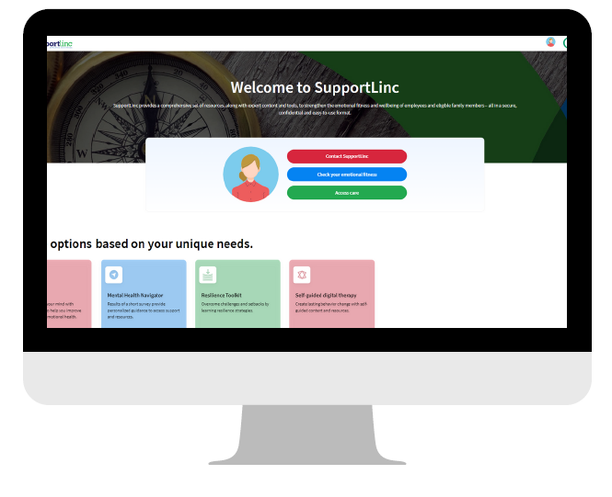
Additional Services
Employee Assistance Program (EAP)
Available to all Grande Associates and their families
Receive up to 6 free sessions per household, per member, per concern
Available 24/7
Free and confidential
Notes:
Grande partners with SupportLinc to provide Associates access to an Employee Assistance Program or EAP at no cost.
This program is available to not only all Associates, but also their immediate family members!
You can receive up to 6 free sessions of face-to-face counseling per family member, per concern
The EAP is available 24/7 and you can access it via phone, web, app, or text
It is completely free and confidential
Log in SupportLinc's website for additional resources today!

Slide 41
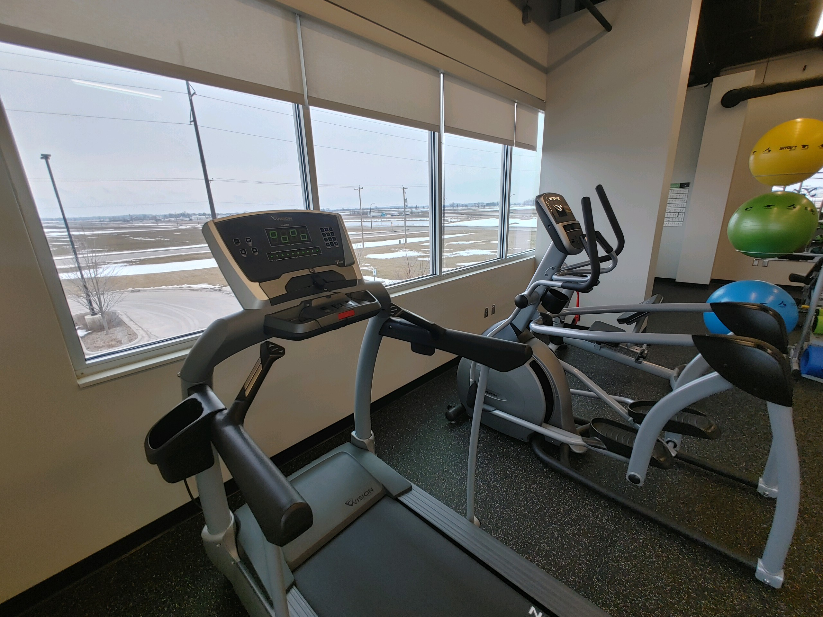
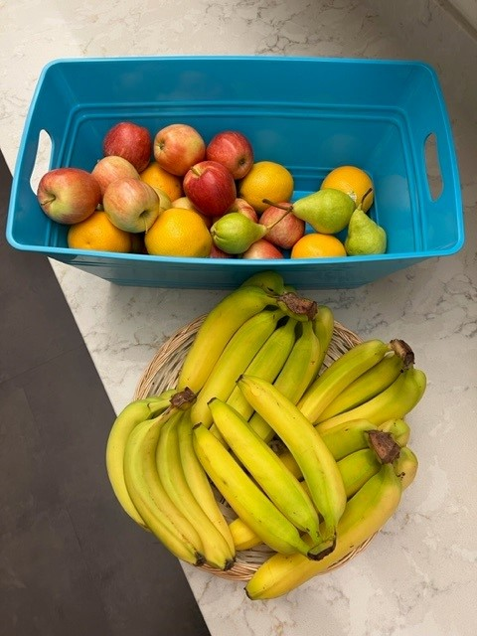
Health & Wellness
Onsite Fitness Centers
24/7 Associate access
Showers at certain locations
Variety of equipment
Fitness Reimbursement Program
50% per month up to $400/year
Fitness centers, race events, at home programs, and more!
Asset Health
Online wellness platform to earn point throughout the year to be eligible for prizes and giveaways.
Points can be earned in a variety of ways from online health assessment, record fitness tracking, biometric screen, quarterly challenges and much more
Notes:
Lastly, Grande offers a lot of great wellness resources to support Associates and their emotional and physical health.
Each facility has an on-site fitness center
Associates can utilize the fitness centers 24/7 via key card access and there is a variety of equipment for use
In addition to our onsite fitness centerse, Grande also offers a fitness reimbursement program.
Associates can receive a 50% reimbursement, up to $400 per year, for things like a gym membership, race events, at home fitness programs, and more!
Visit grandehealth.com for additional information and the forms to complete a reimbursement.
Grande partners with Asset Health for our online wellness platform for Associates and their spouses/domestic partner to earn points throughout the year.
There is a variety of ways to earn points such as an online health assessment, completing biometric screenings, tracking fitness activities, participating in challenges and more!
By engaging in Asset Health, this is also how you can earn your medical premium discount.
Participate today to be eligible for prizes and giveaways that occur throughout the year!

Slide 42
Next Steps
Notes:
This year, action is required from all Associates. Let's discuss next steps you need to take.

Slide 43
Next Steps
Review your options
Reach out with any questions!
Utilize PLANSelect to assist in selecting the best medical plan option
Log into UKG to complete your enrollment
The deadline to enroll is November 2nd
Watch your mail
Once you complete your enrollment, keep an eye out for new insurance cards in December
Notes:
Now that you have additional information, review all of your options for 2025. If you have additional questions, please reach out. In addition, don't forget about PLANSelect and how it can assist you in selecting the best medical plan based on your own situation.
Once you have determined what plan options fit you and your families, log into UKG to complete your enrollment. Don't forget you have until November 2nd to complete your enrollment. Even if you plan on waiving coverage for 2025, please log into UKG to waive coverage. If you don't enroll in coverage by November 2nd, you will not have coverage in 2025 unless you have a qualifying life event throughout the year.
Lastly, in December watch your mail for new insurance cards. Once you receive your new cards, make sure you show your new ID card when you have medical services at a provider's office.

Slide 44
Resources
Reach out with questions!
HR Business Partner
Benefits Team
Benefits Hotline: 920-952-7555
Benefits Email: benefits@grande.com
Grande Benefits Website
www.grandehealth.com
Provider Contact List
All of our providers and their contact information in one spot for you
Notes:
We are here to help you! There are many resources available to you during this Open Enrollment period.
For any questions, reach out to your HR Business Partner or the Benefits Team.
You can also find additional information out on grandehealth.com such as the videos, forms and much more.
Lastly, on the last page of the Open Enrollment book, there is a provider contact list with all of the contact information for our providers, in one spot for you. Feel free to contact these provider's if you have specific questions for them.

Slide 45
Online Enrollment – UKG
How do I enroll?
Enrollment is completed in UKG, accessible at work or home
When is Open Enrollment?
October 20th – November 2nd
*If enrolling any dependents, you will need their date of birth and Social Security Number.
Notes:
As mentioned, once you are ready, make sure you log into UKG to complete your enrollment. As a reminder, Open Enrollment is ACTIVE this year – this means you need to log into UKG to enroll or waive coverage.
To complete your enrollment, log into UKG and go to myself, then Open Enrollment.
The timeframe to complete your enrollment is October 20th – November 2nd.
If you are enrolling any dependents, make sure you have their date of birth and Social Security Number on hand as you will have to provide this information.
While you are in UKG, don't forget to update your life insurance beneficiaries and review your address.

Slide 46
Questions
Thank you!
Notes:
Thank you for attending our 2025 Open Enrollment benefits meeting! Please take this information home and review it. We are here to support you, so please reach out with any questions you have.

